Slide 1
Data, Environment and Society,
Lecture 18: Environmental Justice
Instructor: Duncan Callaway
GSI: Salma Elmallah
October 31, 2019

Slide 2
Outline
Last time:
Dan Kammen guest lecture
  Reading: Sunter et al
EJ:
  History of Environmental Racism
Today
EJ cont’d: Modes of justice
…and regression trees

Slide 3

Reminder: What is Environmental Racism?
It is present when communities of color are
  more heavily targeted for hazardous industries than other communities
  Disproportionately exposed to polluted water, air, soil
Does it need to be intentional to matter?
  This remains a debate among stakeholders.
Notes:
Very important to understand: “Targeting” may not be intentional.
Q: How might this come about in the absence of intention?
A1: If corporations and governments take advantage of “under-resourced” communities in search of the politically and economically easiest places to locate polluting industries
A2: If low income groups move into places where they are disproportionately exposed.
This “chicken and egg” piece is central to the historical debate. Does it matter going forward?
Key issue in debates are whether the intent is there, Clinton I signed an executive order that assured it didn’t matter if there was intent.

Slide 4
Environmental Justice
(for Thursday 10/31 lecture)

Slide 5
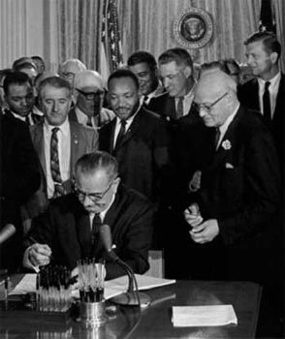
Title VI of the Civil Rights Act of 1964
“No person in the United States shall, on the ground of race, color, or national origin, be excluded from participation in, be denied the benefits of, or be subjected to discrimination under any program or activity receiving Federal financial assistance.”

Slide 6
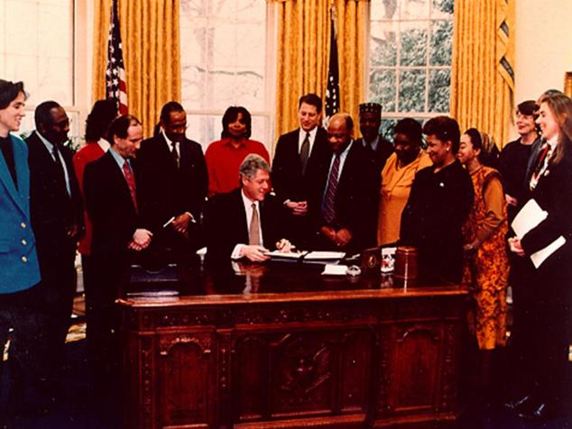
February 11, 1994, Executive Order 12898
“In accordance with Title VI
of the Civil Rights Act of
1964, each Federal agency shall ensure that all programs or activities receiving Federal financial assistance that affect human health or the environment do not directly, or through contractual or other arrangements, use criteria, methods, or practices that discriminate on the basis of race, color, or national origin.”
Notes:
This is the point at which we codified the idea of intent vs. impact.

Slide 7
Environmental Justice
“Environmental justice is the fair treatment and meaningful involvement of all people regardless of race, color, national origin, or income, with respect to the development, implementation, and enforcement of environmental laws, regulations, and policies.” (US EPA)
Notes:
Question: is this the right definition? Are there problems with this definition?
Some thoughts
Are there groups that are not listed here? (Gender and women’s health? Age?)
Whose job is it to prove that treatment is unfair? What can communities without resources to identify and raise issues to government do?

Slide 8
Fair treatment?
Fair treatment: “no group of people, including a racial, ethnic, or socioeconomic group, should bear a disproportionate share of the negative environmental consequences resulting from industrial, municipal, and commercial operations or the execution of federal, state, local, and tribal programs and policies” (US EPA)
Notes:
That’s pretty broad! Can it be attained? Are there alternative ways to think about justice? A major complicating factor:
People may be moving to polluted areas willingly (why?)
A broader economic analysis may permit a view that people can live in more polluted places, so long as there are commensurate benefits to outweigh the costs. We’ll talk a bit more about this when we talk about Pastor.

Slide 9
Pastor’s (2007) Questions
Is the pattern of inequity simply a manifestation of market outcomes rather than discrimination?
Is the pattern a result of moves to higher risk areas driven by choice rather than dictate?
  This is the so-called chicken-and-egg problem
Are there real and consequential effects?
Notes:
These are questions that academics debate.
I want to discuss for a moment if and how these questions relate to the definition of environmental racism that we have introduced.
Q: Which of these questions are more relevant to environmental racism than others? Which is more consequential for environmental justice?
ER: The first two points focus on the question of intent to discriminate versus “market outcomes” or choice on the part of people of color.
However if you consider the earlier definition, intent is not a necessary condition. Therefore we can dismiss those questions as moot for the purpose of establishing whether or not ER is at play.
EJ: The first two questions come into play here. They define the path forward for seeking justice.

Slide 10
Discussion questions
What's the difference between environmental racism and environmental justice?
  What are some of the ways Pastor suggests achieving the latter?
How have EJ and environmental movements differed in their approach to mobilizing science?
Discuss strengths and weaknesses of Pastor's summarized results
  We have a “problem of disproportionate exposure by race and class"
  His claim that this exposure is the outcome of power in decision making rather than "efficient" market outcomes.

Slide 11
Pastor’s alternative perspective on justice
Do not focus only on environment in definition of fair treatment
First, establish community’s property rights:
  Clean environment is a community’s property to do with as they wish
Then, broaden view of property to extend beyond environmt
  Productive capital, Financial capital, Human capital.
A risk assessment / benefit-cost analysis lens would support this view

Slide 12
But a cautionary tale: Risk assessment / BCA to the extreme
Lawrence H. Summers has been dogged by a memo, bearing his name, purporting to advocate exporting polluting industries to poor nations ("underpopulated countries in Africa are vastly underpolluted") and dumping toxic wastes there ("the economic logic…is impeccable"). The memo, dated December 12, 1991, during his service as vice president and chief economist of the World Bank, found its way to the press, and has since circulated widely on the Internet. It was the subject of a question at his March 11 news conference at Loeb House, and of student protests then and the next day. Summers responded to the reporter, "I think the best that can be said is to quote La Guardia and say, "When I make a mistake, it’s a whopper.’"
https://www.harvardmagazine.com/2001/05/toxic-memo.html
Notes:
We focus on capacity and responsibility for obvious reasons… these are two of the official principles of the UN Climate Convention, prominent in its famous preambular text. They are basis of most discussions of global obligations, and not just in the climate regime.

Slide 13
The Summers Memo
DATE: December 12, 1991
TO: Distribution
FR: Lawrence H. Summers
Subject: GEP
'Dirty' Industries: Just between you and me, shouldn't the World Bank be encouraging MORE migration of the dirty industries to the LDCs. I can think of three reasons:
1) The measurements of the costs of health impairing pollution depends on the foregone earnings from increased morbidity and mortality. From this point of view a given amount of health impairing pollution should be done in the country with the lowest cost, which will be the country with the lowest wages. I think the economic logic behind dumping a load of toxic waste in the lowest wage country is impeccable and we should face up to that.
2) The costs of pollution are likely to be non-linear as the initial increments of pollution probably have very low cost. I've always thought that under-populated countries in Africa are vastly UNDER-polluted, their air quality is probably vastly inefficiently low compared to Los Angeles or Mexico City. Only the lamentable facts that so much pollution is generated by non-tradable industries (transport, electrical generation) and that the unit transport costs of solid waste are so high prevent world welfare enhancing trade in air pollution and waste.
3) The demand for a clean environment for aesthetic and health reasons is likely to have very high income elasticity. The concern over an agent that causes a one in a million change in the odds of prostrate cancer is obviously going to be much higher in a country where people survive to get prostrate cancer than in a country where under 5 mortality is is 200 per thousand. Also, much of the concern over industrial atmosphere discharge is about visibility impairing particulates. These discharges may have very little direct health impact. Clearly trade in goods that embody aesthetic pollution concerns could be welfare enhancing. While production is mobile the consumption of pretty air is a non-tradable.
The problem with the arguments against all of these proposals for more pollution in LDCs (intrinsic rights to certain goods, moral reasons, social concerns, lack of adequate markets, etc.) could be turned around and used more or less effectively against every Bank proposal for liberalization.
Notes:
We focus on capacity and responsibility for obvious reasons… these are two of the official principles of the UN Climate Convention, prominent in its famous preambular text. They are basis of most discussions of global obligations, and not just in the climate regime.

Slide 14
Rawls on Justice
In order to facilitate the construction of a just society one needs to revert to a hypothetical 'original ignorance' (or what Rawls calls a 'Veil of Ignorance'), so that all decisions are made from a level playing field. Without this, unfair advantages will be had by some at the expense of others.
Attainable?
Notes:
John Rawls – philosopher.
This is not the only lens to look through
But when things come to court, often people ask if they’ve passed the “Rawlsian test.”
What is the veil of ignorance? The basic idea is as follows:
Imagine you are a self-interested individual – you want what is best for you
BUT you do not know your race, gender, age, generation to which you belong etc.
HOWEVER you do know the general types of situations humans can find themselves in
AND YOU DO KNOW about psychology and human nature.
Then we let that individual choose the rules or decisions that govern the world.
That person would not want to belong to any of the discriminated-against groups. So the rules would be as fair as possible.
Interestingly, Rawls includes generations – people that might live many years in the future. This of course has implications for climate change.

Slide 15
Discussion questions
What's the difference between environmental racism and environmental justice?
  What are some of the ways Pastor suggests achieving the latter?
How have EJ and environmental movements differed in their approach to mobilizing science?
Discuss strengths and weaknesses of Pastor's summarized results
  We have a “problem of disproportionate exposure by race and class"
  His claim that this exposure is the outcome of power in decision making rather than "efficient" market outcomes.

Slide 16
Pastor 2007 quote:
“…traditional environmentalists tend to favour 'rational' processes of debate objective scientific research on hazards and their risks. As Guana points out, such frameworks tend to produce negotiations between businesses and their hired experts, environmental organizations and their (hired and sometimes volunteer) experts, and government regulators. By contrast, EJ activists favour 'democratic' epistemologies in which community participation facilitates story-telling about lived experiences; in Foreman's view, this simply leads to 'theatrics’ but in the minds of many EJ advocates, this allows for community empowerment”
Notes:
This quote addresses the EJ vs environment issue

Slide 17
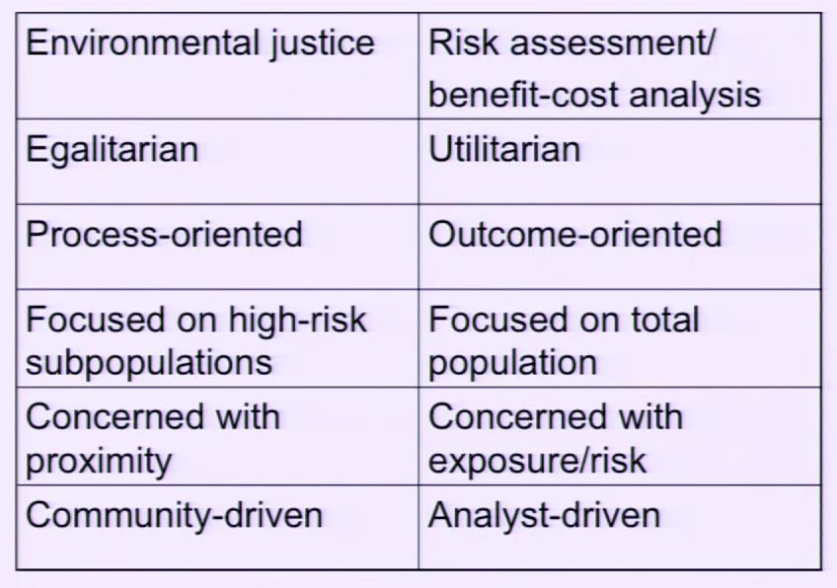
How is EJ used operationally?
Notes:
Each column represents two alternative ways of operationalizing policy
The right column is the status quo – how gov’t typically approaches societal problems including environmental ones
But the outcomes – intended or not – of the right column process can lead to negative outcomes for certain communities.
For example – if a facility is believed to be acceptable from an emissions perspective, and it needs to be sited SOMEWHERE, a utilitarian, outcome oriented approach that focus on the population as a whole rather than high risk or under represented groups, that facility may be more likely to wind up in a community of color or a poor community.
Now it may be the case that the facility is on paper clean and introduces low exposure to individuals, but in practice
Communities still live in the shadow of these faciliities
Unexpected events (explosions) could create exposure events that no one planned for.
This set of issues raises an important tension that Pastor raises in his “reflections” paper, namely that
Traditional environmentalists tend to favor 'rational' processes of debate objective scientific research on hazards and their risks. As Guana points out, such frameworks tend to produce between businesses and their hired experts, environmental organizations and their (hired and sometimes volunteer experts)
EJ activists favor 'democratic' epistemologies in which community participation facilitates story-telling about lived experiences;
this leads to 'theatrics" but in the minds of many EJ advocates, this allows for community empowerment.
While these efforts have sometimes been attacked for yielding 'unscientific' data, the results are often quite solid and have informed and mobilized local communities.

Slide 18
Discussion questions
What's the difference between environmental racism and environmental justice?
  What are some of the ways Pastor suggests achieving the latter?
How have EJ and environmental movements differed in their approach to mobilizing science?
Discuss strengths and weaknesses of Pastor's summarized results
  We have a “problem of disproportionate exposure by race and class"
  His claim that this exposure is the outcome of power in decision making rather than "efficient" market outcomes.

Slide 19
Finally, some other factors to consider
What are the roots of environmental racism, and why is EJ so hard?
  Segregation (and redlining)
  Correlation between race and class.
  Access to easy places to pollute means firms can avoid further reducing impacts of pollution.

